Slide 1
Screenshots for How-to tab
https://camsys.shinyapps.io/TEA-CART/

Slide 2
Notes:
Step 1

Slide 3
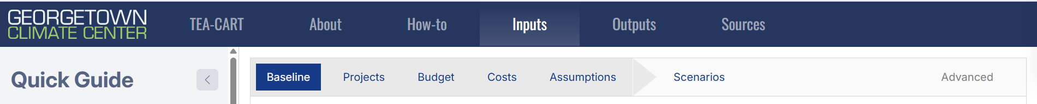
Notes:
Step 2

Slide 4
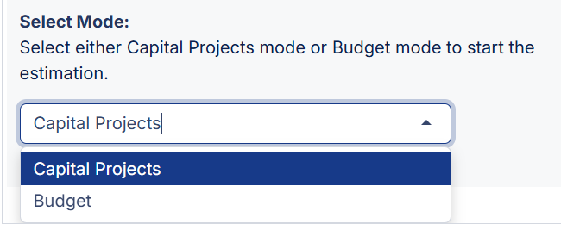
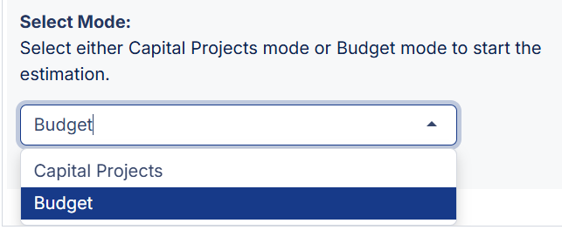
OR
Notes:
Step 3

Slide 5
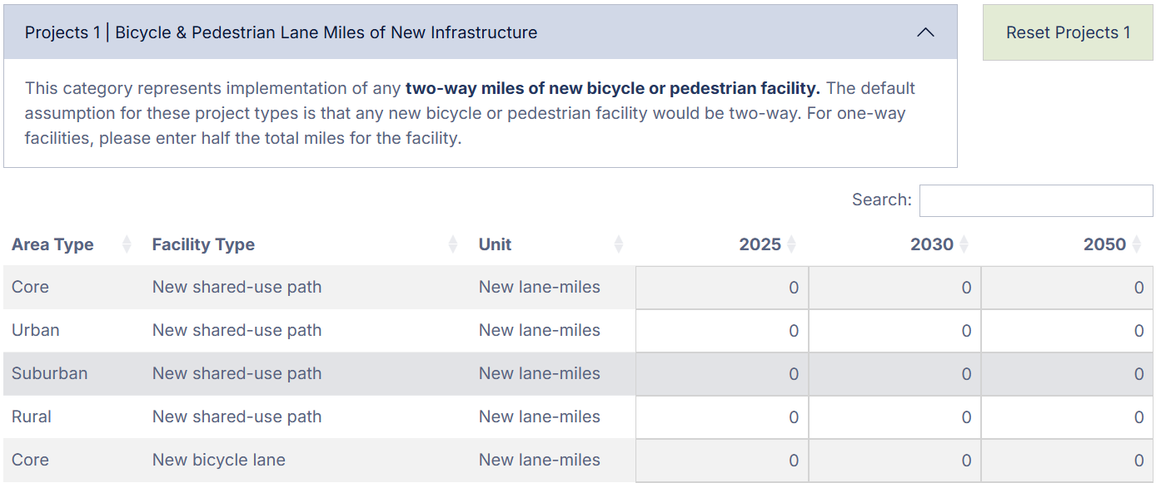
Double-click the value (here, a ‘0’) to begin editing.
Notes:
Step 4

Slide 6
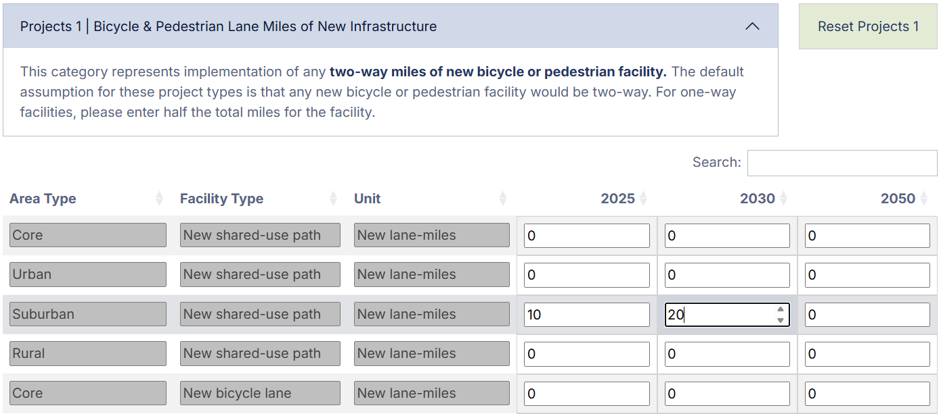
Hit Ctrl + Enter to finish entering, or Esc to cancel.
Notes:
Step 5

Slide 7
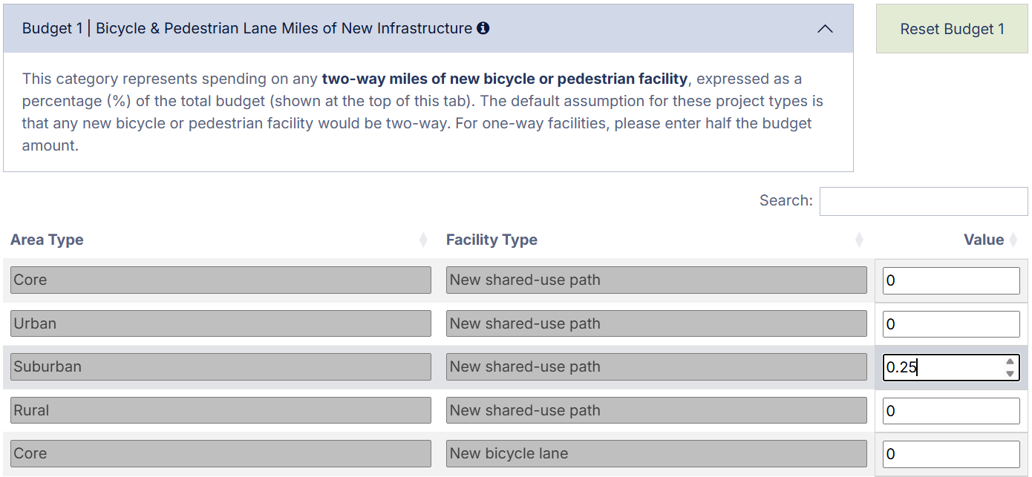
Similarly, in Budget mode, double-click cells to begin editing.
Notes:
Step 6

Slide 8
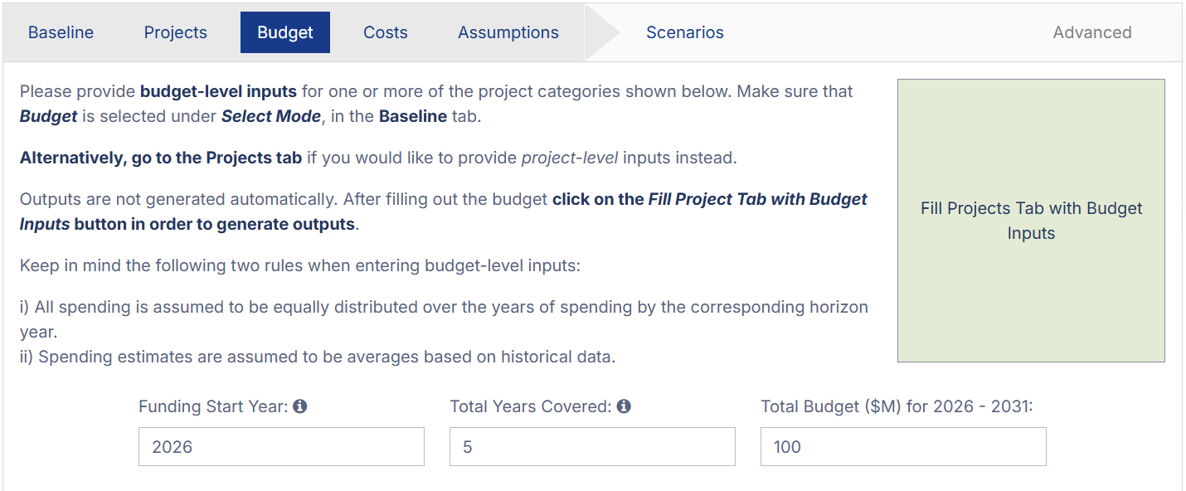
Notes:
Step 7

Slide 9
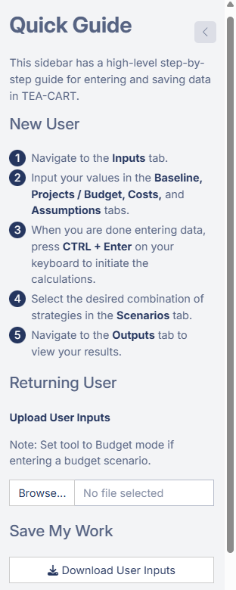
Notes:
Step 8

Slide 10
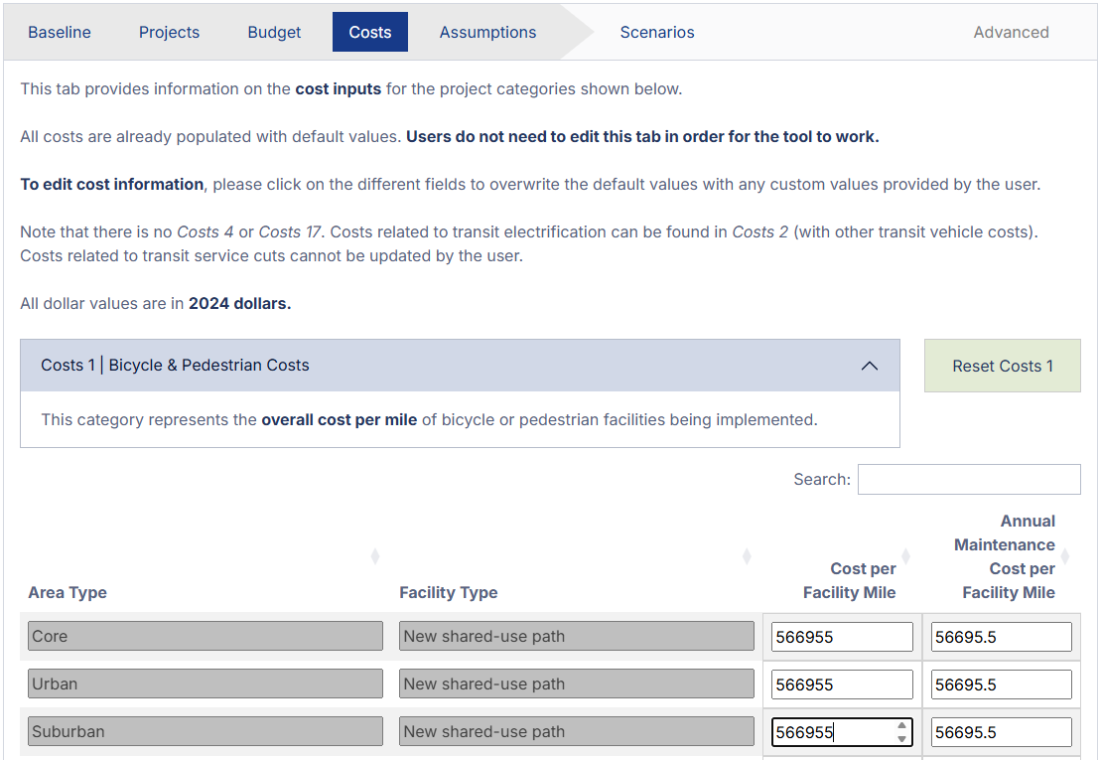
Default values can be changed.
Notes:
Step 9

Slide 11
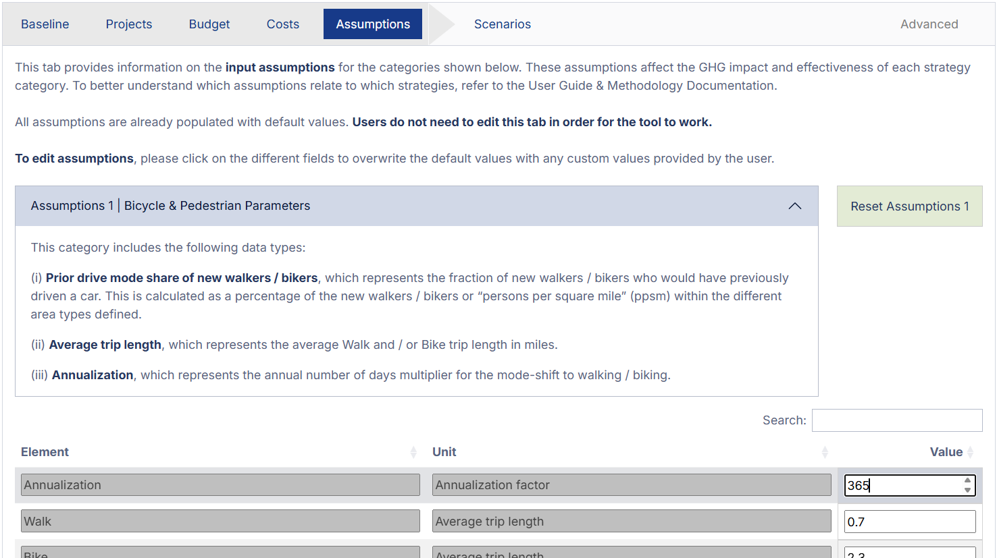
Default values can be changed.
Notes:
Step 10

Slide 12
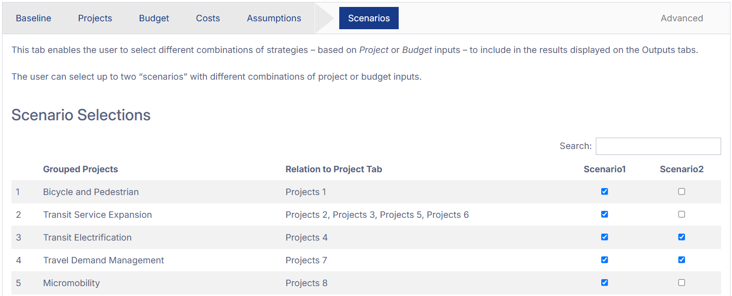
By default, all project types will be selected under Scenario 1. Click the checkboxes to add or remove project types.
Notes:
Step 11

Slide 13
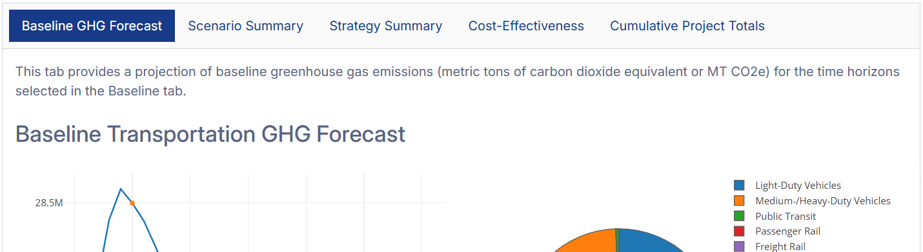
Notes:
Step 13

Slide 14
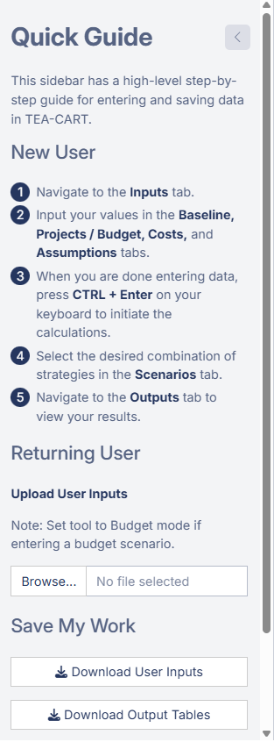
Notes:
Step 14

Slide 15
Old Versions >>

Slide 16
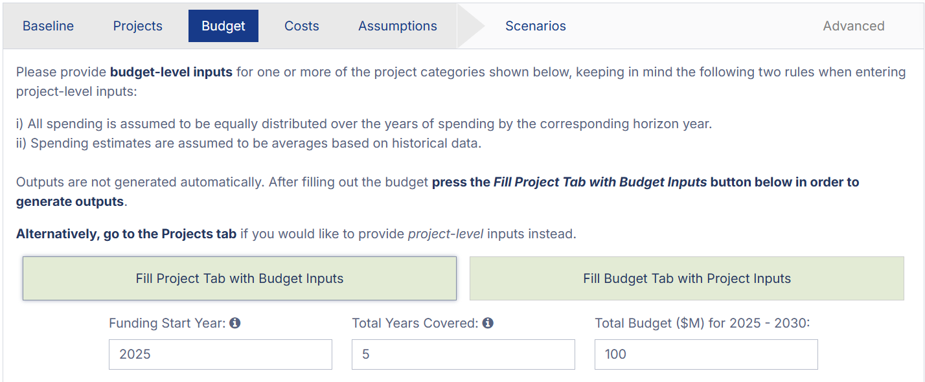
Notes:
Step 7 (OLD)

Slide 17
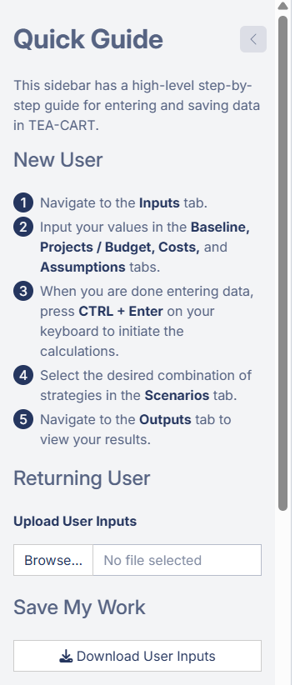
Notes:
Step 8 (OLD)

Slide 18
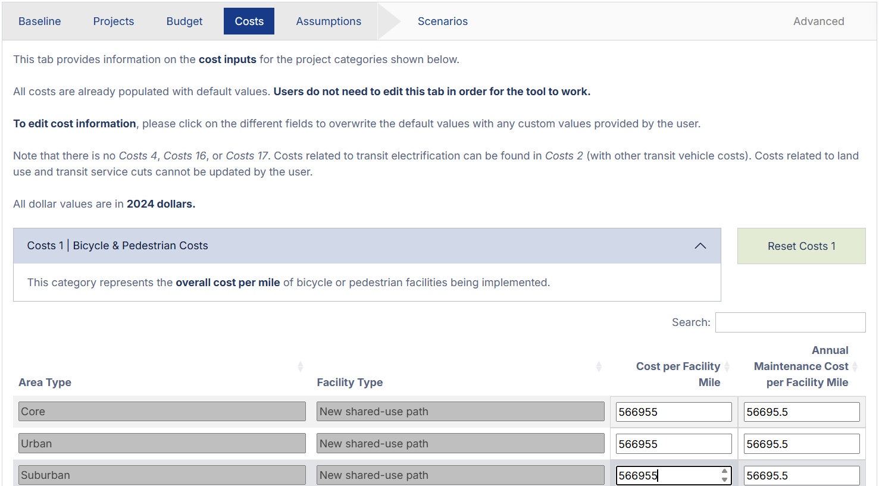
Default values can be changed.
Notes:
Step 9 (OLD)

Slide 19
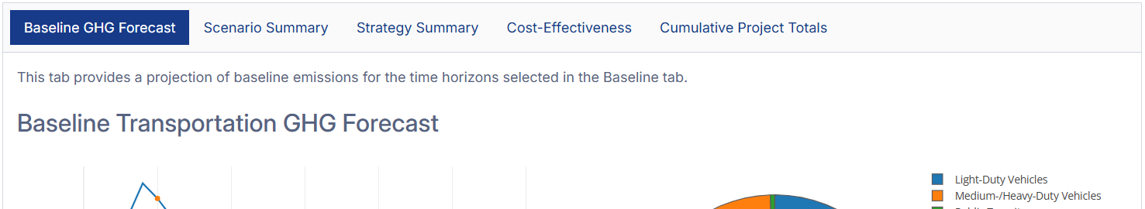
Notes:
Step 13 (OLD)

Slide 20
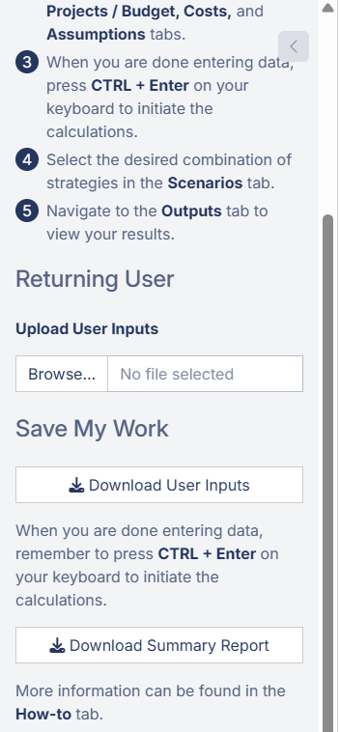
Notes:
Step 14 (OLD)

